Slide 1
ANDROID STUDIO
Bhanu Manoj Bade
Nagendra Babu Dosapati

Slide 2
INTRODUCTION
What is android studio?
Android Studio is the official integrated development environment for Google's Android operating system, built on JetBrains' IntelliJ IDEA software and designed specifically for Android development.
In this presentation, we are discussing on ICP-8, ICP-10 and ICP-11, which includes are the required features for the starter to know and some programming code.

Slide 3
InTrODUCTION
Project Structure
Android studio displays the project in the project files in the android project view and the project contains the following folders
Manifest: Contains AndroidManifest.xml file
Java: Contains Java source code file, which includes Junit test cases.
Res: Contains all non-code resources, such as XML layouts, UI strings, and bitmap images.

Slide 4
FEATUREs
Classes
Android studio contains different packages and each package consists of multiple classes and in this presentation we are discussing on some of the most used classes in the package named android.widget.
TextView: Displays the text to the user.
EditText: Used for entering and modifying text
Button: The user can tap or click to perform an action.
CheckBox: It is a specific type of two-states button that can be either checked or unchecked

Slide 5
FEATURES
ImageView: Displays image resources.
RadioButton: A radio button is a two-states button that can be either checked or unchecked. When the radio button is unchecked, the user can press or click it to check it.
Toast: A toast is a view containing a quick little message for the user.
RelativeLayout: A Layout where the positions of the children can be described in relation to each other or to the parent.
GridLayout: A layout that places its children in a rectangular grid.
LinearLayout: A layout that arranges other views either horizontally in a single column or vertically in a single row.

Slide 6
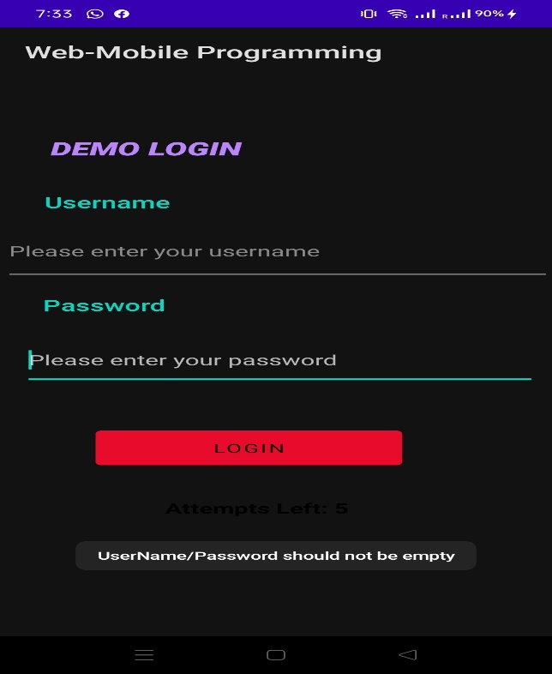
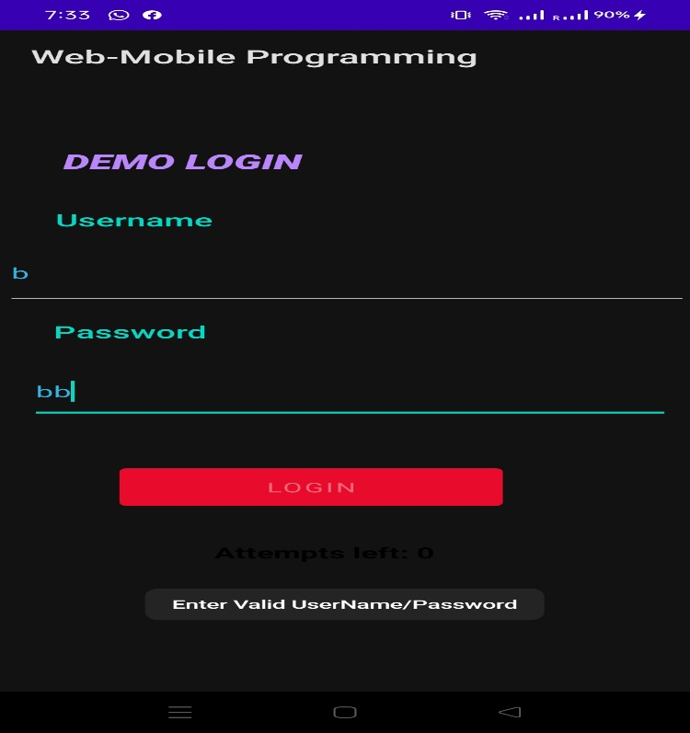

Slide 7
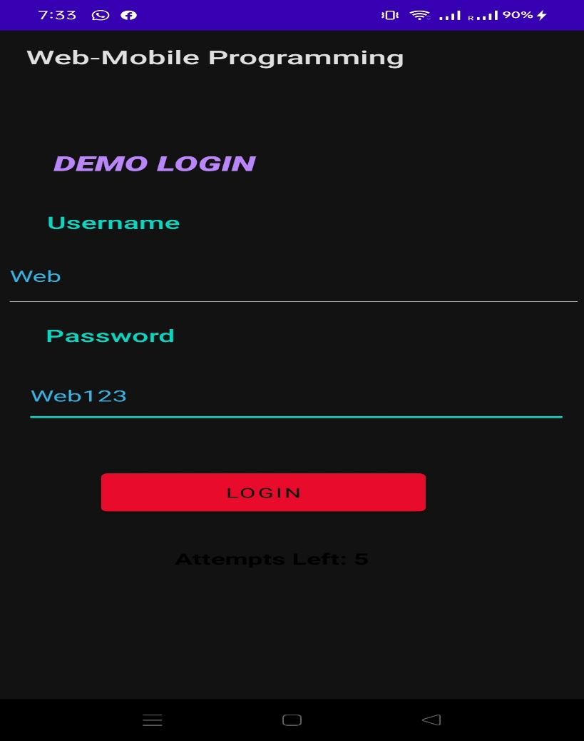
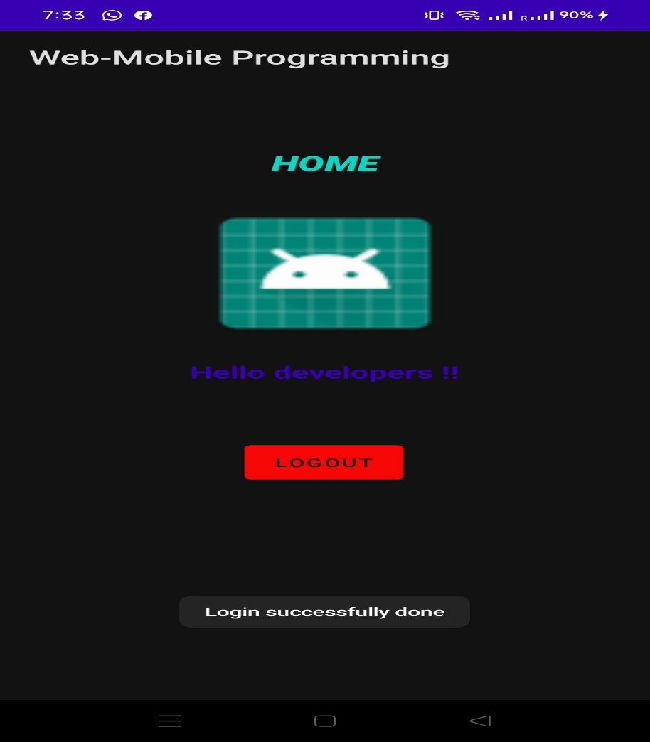

Slide 8
API CALLING
Retrofit is a type-safe REST client for Android, Java and Kotlin developed by Square. The library provides a powerful framework for authenticating and interacting with APIs and sending network requests with OkHttp.
We need to create the Retrofit instances and creating address.
Syntax: Retrofit retrofit = new Retrofit.Builder().baseUrl(BASE_URL).addConverterFactory(GsonConverterFactory.create()).build();
Endpoint calling:
Syntax: @GET(‘user/{username}’)

Slide 9
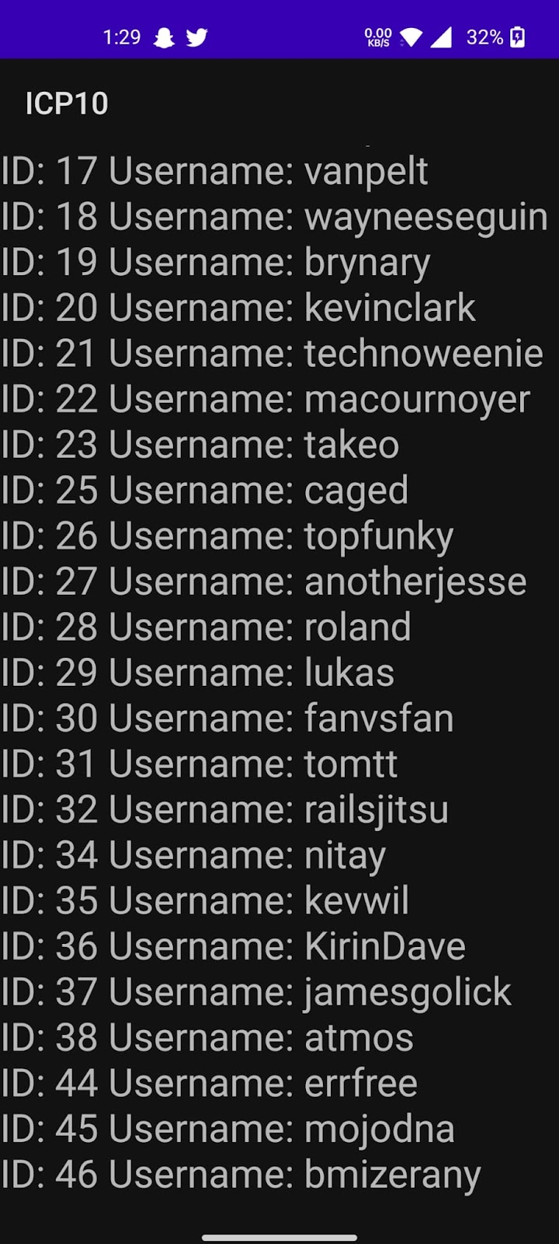

Slide 10
TEXT TO SPEECH
Instance creation and calling OnInitListener.
Language setting:
Syntax: object.setLanguage(Local.UK);
Speak method calling
Syntax: ttobj.speak(toSpeak, TextToSpeech.QUEUE_FLUSH, null);

Slide 11
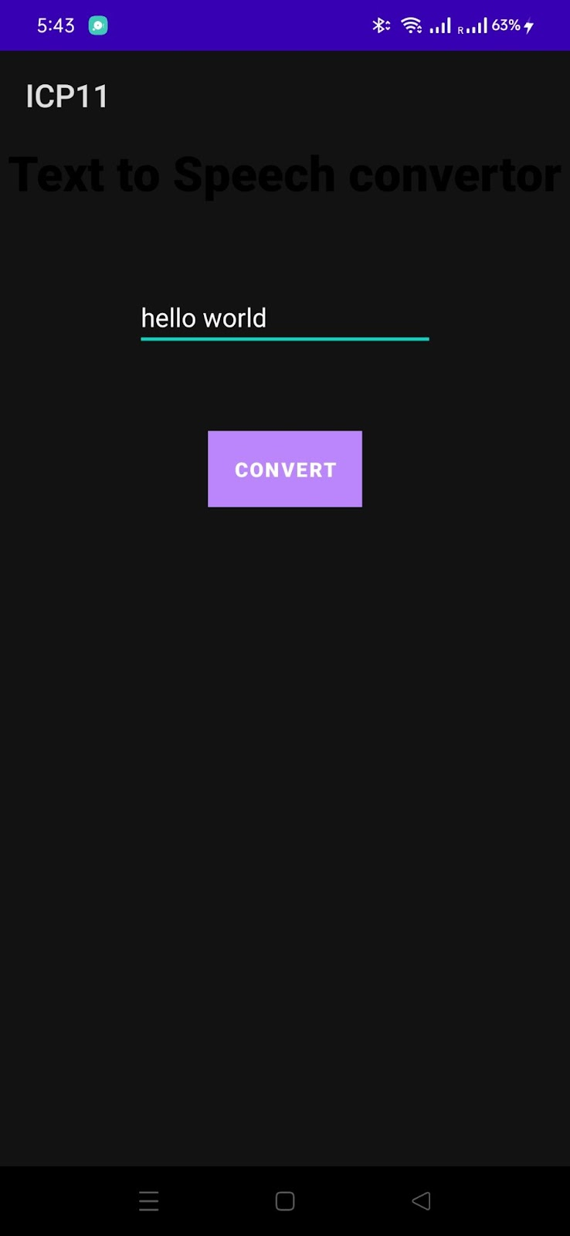

Slide 12


